Slide 1
PRESENTATION TEMPLATE

Slide 2
Slide titles are up here
And the content is here.
This is still quite simple template, as I haven’t styled everything yet. But I guess it still gives a good starting point.

Slide 3
Third slide

Slide 4
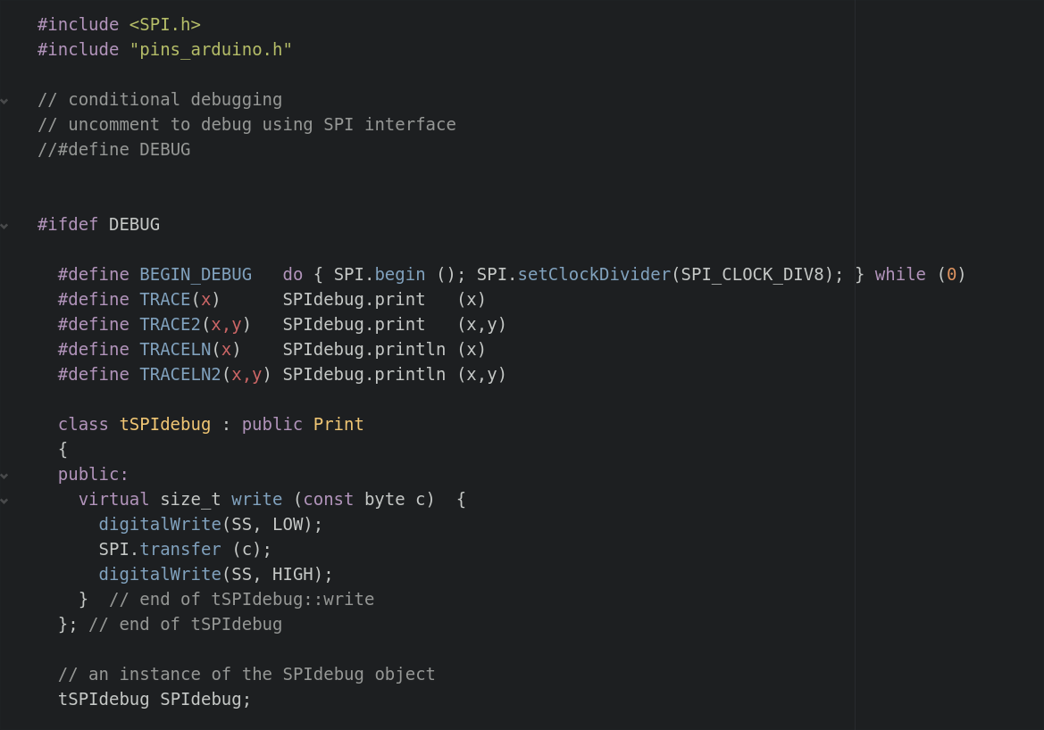
QUICK TIP
If you need a screenshot (or syntax highlighted code snippet) in Fedora:
Switch to black on white (the opposite can be hard to read on beamers)
Ctrl-Shift-PrintScreen
Select rectangle area to screenshot
Paste into slides →

